Slide 1

Chapter 20 Recursion

Slide 2
Motivations
Suppose you want to find all the files under a directory that contains a particular word. How do you solve this problem? There are several ways to solve this problem. An intuitive solution is to use recursion by searching the files in the subdirectories recursively.

Slide 3
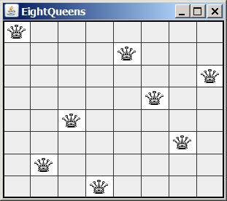
Motivations
The Eight Queens puzzle is to place eight queens on a chessboard such that no two queens are on the same row, same column, or same diagonal, as shown in Figure 20.1. How do you write a program to solve this problem? A good approach to solve this problem is to use recursion.

Slide 4
Objectives
To know what a recursive method is and the benefits of using recursive methods (§20.1).
To determine the base cases in a recursive method (§§20.2-20.5).
To understand how recursive method calls are handled in a call stack (§§20.2-20.3).
To solve problems using recursion (§§20.2-20.5).
To use an overloaded helper method to derive a recursive method (§20.5).
To get the directory size using recursion (§20.6).
To solve the Towers of Hanoi problem using recursion (§20.7).
To draw fractals using recursion (§20.8).
To understand the relationship and difference between recursion and iteration (§20.9).

Slide 5

Computing Factorial
factorial(0) = 1;
factorial(n) = n*factorial(n-1);
n! = n * (n-1)!
ComputeFactorial

Slide 6
Computing Factorial
animation
factorial(0) = 1;
factorial(n) = n*factorial(n-1);
factorial(3)

Slide 7
Computing Factorial
animation
factorial(0) = 1;
factorial(n) = n*factorial(n-1);
factorial(3) = 3 * factorial(2)

Slide 8
Computing Factorial
animation
factorial(0) = 1;
factorial(n) = n*factorial(n-1);
factorial(3) = 3 * factorial(2)
= 3 * (2 * factorial(1))

Slide 9
Computing Factorial
animation
factorial(0) = 1;
factorial(n) = n*factorial(n-1);
factorial(3) = 3 * factorial(2)
= 3 * (2 * factorial(1))
= 3 * ( 2 * (1 * factorial(0)))

Slide 10
Computing Factorial
animation
factorial(0) = 1;
factorial(n) = n*factorial(n-1);
factorial(3) = 3 * factorial(2)
= 3 * (2 * factorial(1))
= 3 * ( 2 * (1 * factorial(0)))
= 3 * ( 2 * ( 1 * 1)))

Slide 11
Computing Factorial
animation
factorial(0) = 1;
factorial(n) = n*factorial(n-1);
factorial(3) = 3 * factorial(2)
= 3 * (2 * factorial(1))
= 3 * ( 2 * (1 * factorial(0)))
= 3 * ( 2 * ( 1 * 1)))
= 3 * ( 2 * 1)

Slide 12
Computing Factorial
animation
factorial(0) = 1;
factorial(n) = n*factorial(n-1);
factorial(3) = 3 * factorial(2)
= 3 * (2 * factorial(1))
= 3 * ( 2 * (1 * factorial(0)))
= 3 * ( 2 * ( 1 * 1)))
= 3 * ( 2 * 1)
= 3 * 2

Slide 13
Computing Factorial
animation
factorial(0) = 1;
factorial(n) = n*factorial(n-1);
factorial(3) = 3 * factorial(2)
= 3 * (2 * factorial(1))
= 3 * ( 2 * (1 * factorial(0)))
= 3 * ( 2 * ( 1 * 1)))
= 3 * ( 2 * 1)
= 3 * 2
= 6

Slide 14

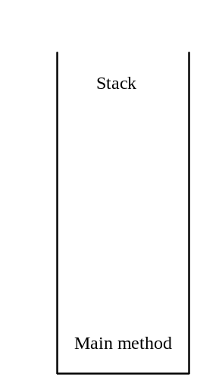
Trace Recursive factorial
animation
Executes factorial(4)

Slide 15

Trace Recursive factorial
animation
Executes factorial(3)

Slide 16
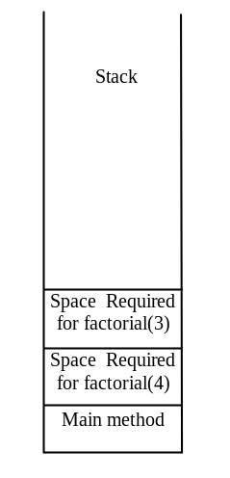
Trace Recursive factorial
animation
Executes factorial(2)

Slide 17
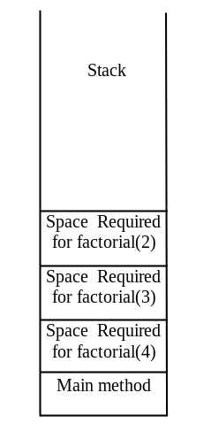
Trace Recursive factorial
animation
Executes factorial(1)

Slide 18
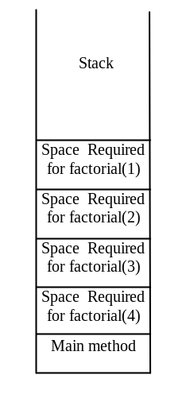
Trace Recursive factorial
animation
Executes factorial(0)

Slide 19
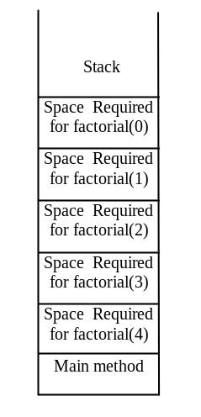
Trace Recursive factorial
animation
returns 1

Slide 20
Trace Recursive factorial
animation
returns factorial(0)

Slide 21
Trace Recursive factorial
animation
returns factorial(1)

Slide 22
Trace Recursive factorial
animation
returns factorial(2)

Slide 23
Trace Recursive factorial
animation
returns factorial(3)

Slide 24
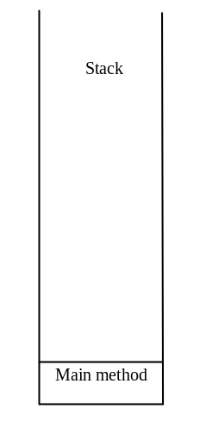
Trace Recursive factorial
animation
returns factorial(4)

Slide 25

factorial(4) Stack Trace

Slide 26
Other Examples
f(0) = 0;
f(n) = n + f(n-1);

Slide 27
Fibonacci Numbers
Fibonacci series: 0 1 1 2 3 5 8 13 21 34 55 89…
indices: 0 1 2 3 4 5 6 7 8 9 10 11
fib(0) = 0;
fib(1) = 1;
fib(index) = fib(index -1) + fib(index -2); index >=2
fib(3) = fib(2) + fib(1) = (fib(1) + fib(0)) + fib(1) = (1 + 0) +fib(1) = 1 + fib(1) = 1 + 1 = 2
ComputeFibonacci

Slide 28

Fibonnaci Numbers, cont.

Slide 29
Characteristics of Recursion
All recursive methods have the following characteristics:
  One or more base cases (the simplest case) are used to stop recursion.
  Every recursive call reduces the original problem, bringing it increasingly closer to a base case until it becomes that case.
In general, to solve a problem using recursion, you break it into subproblems. If a subproblem resembles the original problem, you can apply the same approach to solve the subproblem recursively. This subproblem is almost the same as the original problem in nature with a smaller size.

Slide 30
Problem Solving Using Recursion
Let us consider a simple problem of printing a message for n times. You can break the problem into two subproblems: one is to print the message one time and the other is to print the message for n-1 times. The second problem is the same as the original problem with a smaller size. The base case for the problem is n==0. You can solve this problem using recursion as follows:
public static void nPrintln(String message, int times) {
if (times >= 1) {
System.out.println(message);
nPrintln(message, times - 1);
} // The base case is times == 0
}

Slide 31
Think Recursively
Many of the problems presented in the early chapters can be solved using recursion if you think recursively. For example, the palindrome problem in Listing 7.1 can be solved recursively as follows:
public static boolean isPalindrome(String s) {
if (s.length() <= 1) // Base case
return true;
else if (s.charAt(0) != s.charAt(s.length() - 1)) // Base case
return false;
else
return isPalindrome(s.substring(1, s.length() - 1));
}

Slide 32
Recursive Helper Methods
The preceding recursive isPalindrome method is not efficient, because it creates a new string for every recursive call. To avoid creating new strings, use a helper method:
public static boolean isPalindrome(String s) {
return isPalindrome(s, 0, s.length() - 1);
}
public static boolean isPalindrome(String s, int low, int high) {
if (high <= low) // Base case
return true;
else if (s.charAt(low) != s.charAt(high)) // Base case
return false;
else
return isPalindrome(s, low + 1, high - 1);
}

Slide 33
Recursive Selection Sort
Find the largest number in the list and swaps it with the last number.
Ignore the last number and sort the remaining smaller list recursively.
RecursiveSelectionSort

Slide 34
Recursive Binary Search
Case 1: If the key is less than the middle element, recursively search the key in the first half of the array.
Case 2: If the key is equal to the middle element, the search ends with a match.
Case 3: If the key is greater than the middle element, recursively search the key in the second half of the array.
RecursiveBinarySort

Slide 35
Recursive Implementation
/** Use binary search to find the key in the list */
public static int recursiveBinarySearch(int[] list, int key) {
int low = 0;
int high = list.length - 1;
return recursiveBinarySearch(list, key, low, high);
}
/** Use binary search to find the key in the list between
list[low] list[high] */
public static int recursiveBinarySearch(int[] list, int key,
int low, int high) {
if (low > high) // The list has been exhausted without a match
return -low - 1;
int mid = (low + high) / 2;
if (key < list[mid])
return recursiveBinarySearch(list, key, low, mid - 1);
else if (key == list[mid])
return mid;
else
return recursiveBinarySearch(list, key, mid + 1, high);
}

Slide 36
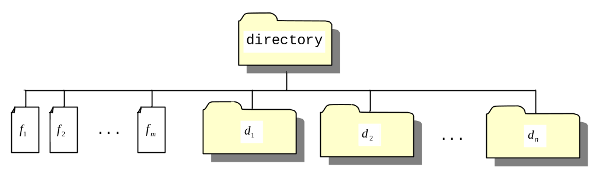
Directory Size
The preceding examples can easily be solved without using recursion. This section presents a problem that is difficult to solve without using recursion. The problem is to find the size of a directory. The size of a directory is the sum of the sizes of all files in the directory. A directory may contain subdirectories. Suppose a directory contains files , , ..., , and subdirectories , , ..., , as shown below.

Slide 37
Directory Size
The size of the directory can be defined recursively as follows:
DirectorySize

Slide 38
Towers of Hanoi
There are n disks labeled 1, 2, 3, . . ., n, and three towers labeled A, B, and C.
No disk can be on top of a smaller disk at any time.
All the disks are initially placed on tower A.
Only one disk can be moved at a time, and it must be the top disk on the tower.

Slide 39
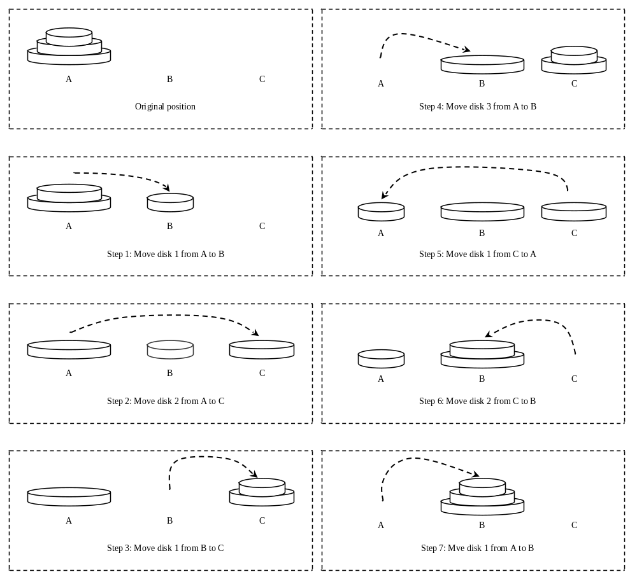
Towers of Hanoi, cont.

Slide 40
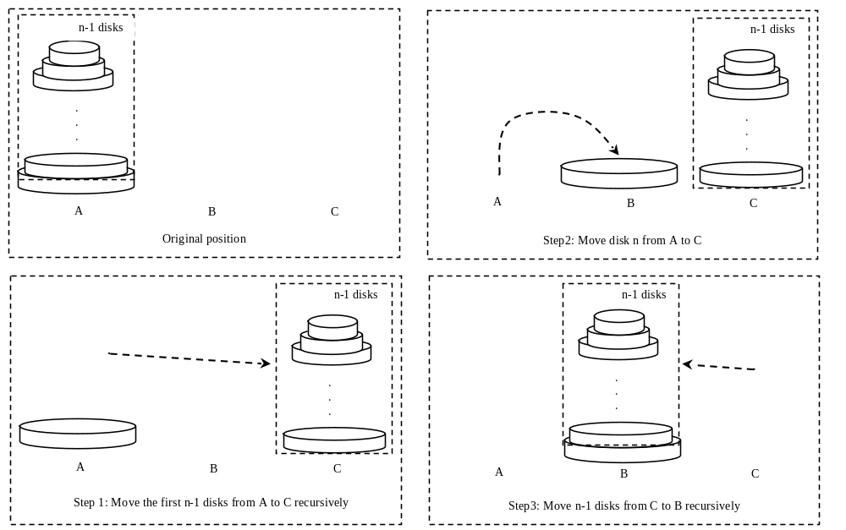
Solution to Towers of Hanoi
The Towers of Hanoi problem can be decomposed into three subproblems.

Slide 41
Solution to Towers of Hanoi
Move the first n - 1 disks from A to C with the assistance of tower B.
Move disk n from A to B.
Move n - 1 disks from C to B with the assistance of tower A.
TowersOfHanoi

Slide 42
Exercise 20.3 GCD
gcd(2, 3) = 1
gcd(2, 10) = 2
gcd(25, 35) = 5
gcd(205, 301) = 5
gcd(m, n)
Approach 1: Brute-force, start from min(n, m) down to 1, to check if a number is common divisor for both m and n, if so, it is the greatest common divisor.
Approach 2: Euclid’s algorithm
Approach 3: Recursive method

Slide 43
Approach 2: Euclid’s algorithm
// Get absolute value of m and n;
t1 = Math.abs(m); t2 = Math.abs(n);
// r is the remainder of t1 divided by t2;
r = t1 % t2;
while (r != 0) {
t1 = t2;
t2 = r;
r = t1 % t2;
}
// When r is 0, t2 is the greatest common
// divisor between t1 and t2
return t2;

Slide 44
Approach 3: Recursive Method
gcd(m, n) = n if m % n = 0;
gcd(m, n) = gcd(n, m % n); otherwise;

Slide 45
Fractals?
A fractal is a geometrical figure just like triangles, circles, and rectangles, but fractals can be divided into parts, each of which is a reduced-size copy of the whole. There are many interesting examples of fractals. This section introduces a simple fractal, called Sierpinski triangle, named after a famous Polish mathematician.

Slide 46
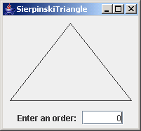
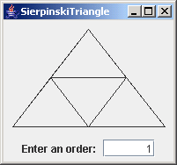
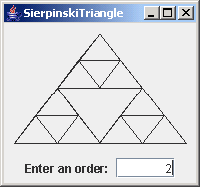
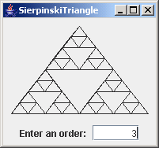
Sierpinski Triangle
It begins with an equilateral triangle, which is considered to be the Sierpinski fractal of order (or level) 0, as shown in Figure (a).
Connect the midpoints of the sides of the triangle of order 0 to create a Sierpinski triangle of order 1, as shown in Figure (b).
Leave the center triangle intact. Connect the midpoints of the sides of the three other triangles to create a Sierpinski of order 2, as shown in Figure (c).
You can repeat the same process recursively to create a Sierpinski triangle of order 3, 4, ..., and so on, as shown in Figure (d).

Slide 47
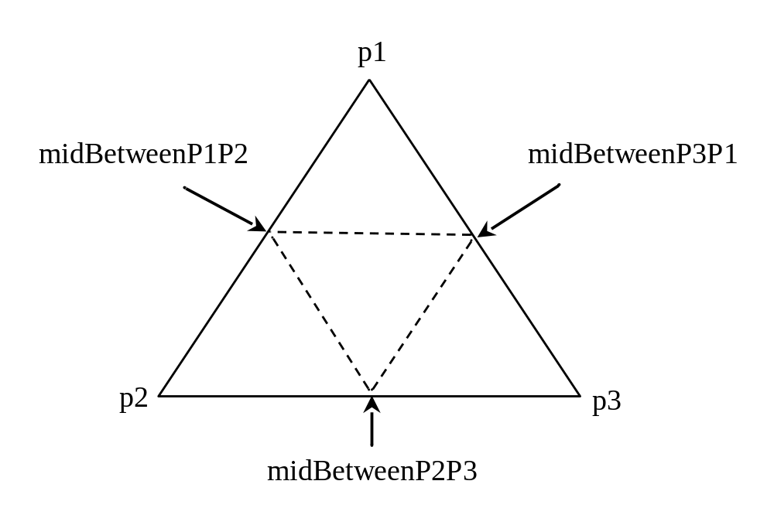
Sierpinski Triangle Solution
SierpinskiTriangle

Slide 48
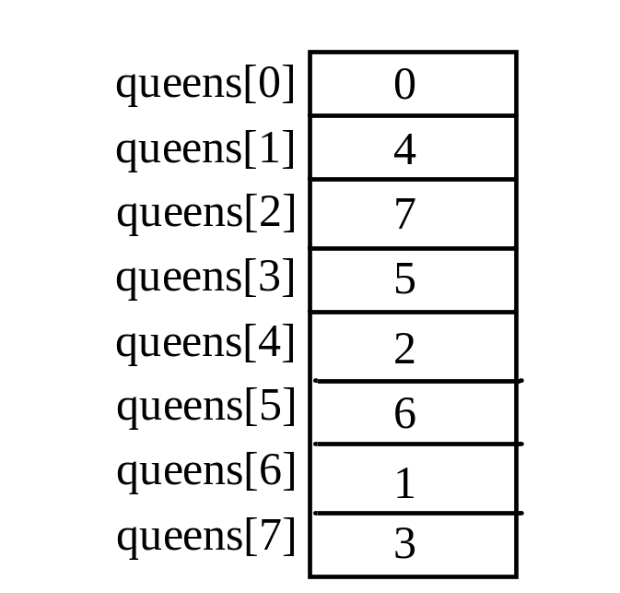
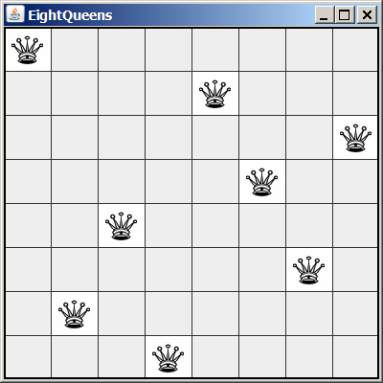
Eight Queens
EightQueens

Slide 49
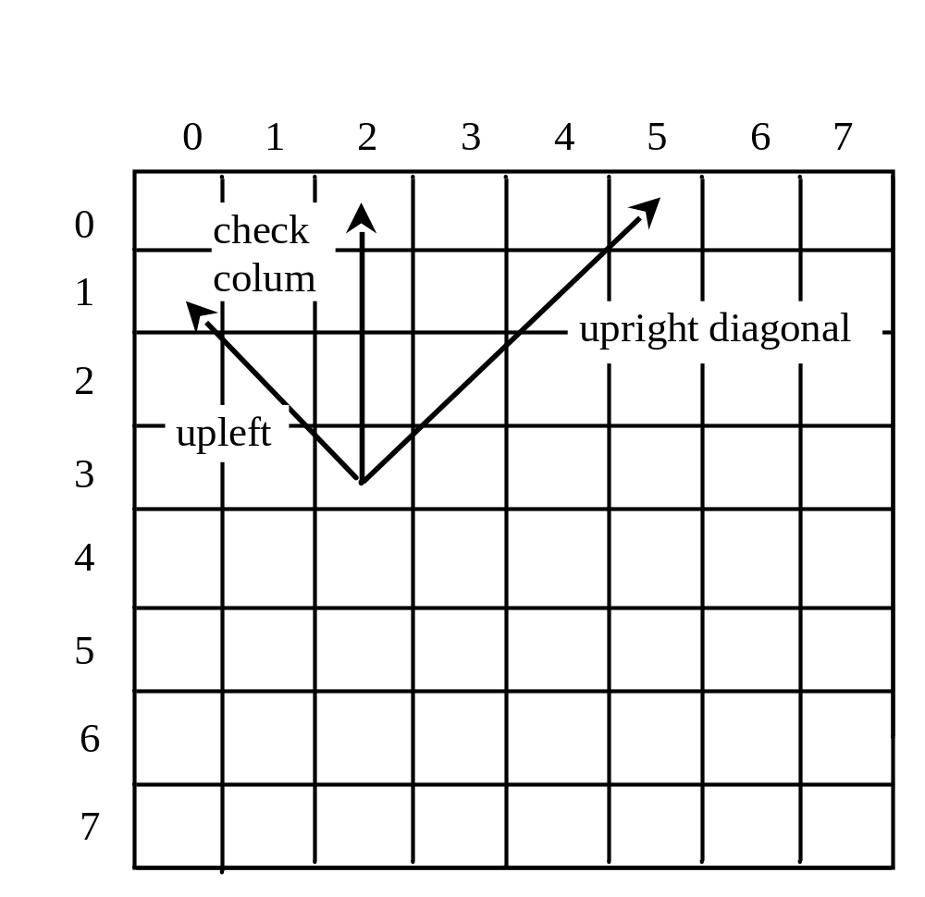
Eight Queens

